Slide 1

Deciding what to try next
Advice for applying machine learning
Machine Learning

Slide 2
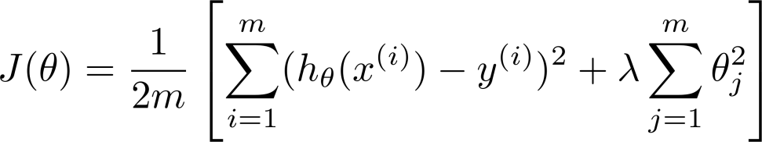
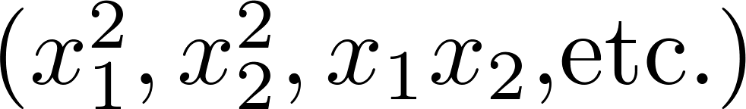
Debugging a learning algorithm:
Suppose you have implemented regularized linear regression to predict housing prices.
However, when you test your hypothesis on a new set of houses, you find that it makes unacceptably large errors in its predictions. What should you try next?
Get more training examples
Try smaller sets of features
Try getting additional features
Try adding polynomial features
Try decreasing
Try increasing

Slide 3
Machine learning diagnostic:
Diagnostic: A test that you can run to gain insight what is/isn’t working with a learning algorithm, and gain guidance as to how best to improve its performance.
Diagnostics can take time to implement, but doing so can be a very good use of your time.

Slide 4
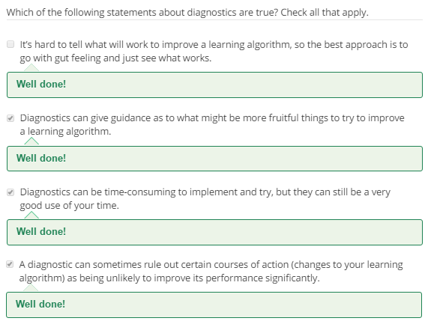

Slide 5
Evaluating a hypothesis
Advice for applying machine learning
Machine Learning

Slide 6




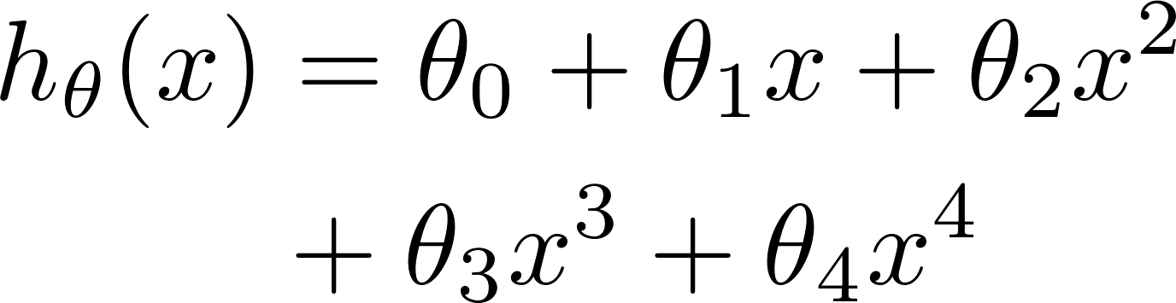


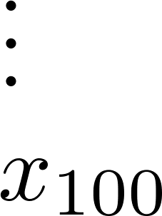
Just because hypothesis has low training error doesn’t mean it’s a good hypothesis (hypothesis might overfit data which leads to failing to generalize new examples in training set). Hence training set error is not a good predictor for how well hypothesis will do for new examples. So, How can we tell hypothesis might be overfitting ? One simple solution is to plot and see, But it is not feasible for large no. of features.
Evaluating your hypothesis
Fails to generalize to new examples not in training set.
price
size of house
no. of bedrooms
no. of floors
size
age of house
average income in neighborhood
kitchen size

Slide 7






Evaluating your hypothesis
Dataset:
Size | Price
2104 | 400
1600 | 330
2400 | 369
1416 | 232
3000 | 540
1985 | 300
1534 | 315
1427 | 199
1380 | 212
1494 | 243

Slide 8

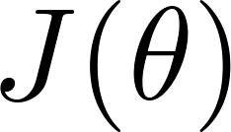
Training/testing procedure for linear regression
Learn parameter from training data (minimizing training error )
Compute test set error:

Slide 9
Training/testing procedure for logistic regression
Learn parameter from training data
Compute test set error:
Misclassification error (0/1 misclassification error):

Slide 10
Model selection and training/validation/test sets
Advice for applying machine learning
Machine Learning

Slide 11
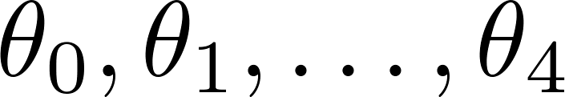
Overfitting example
Once parameters
were fit to some set of data (training set), the error of the parameters as measured on that data (the training error xxxxx) is likely to be lower than the actual generalization error.
price
size

Slide 12
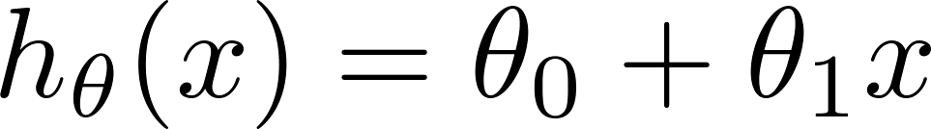
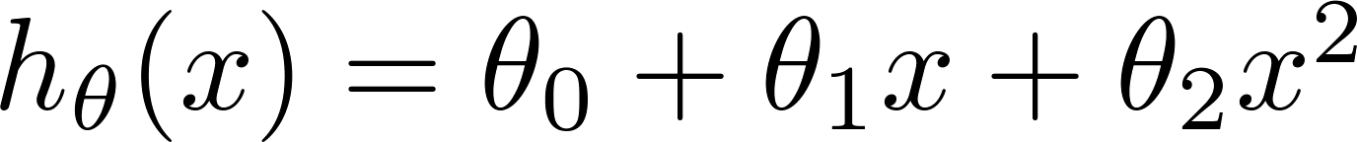
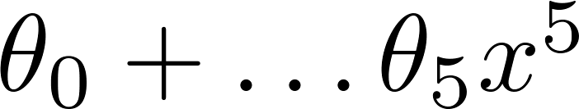
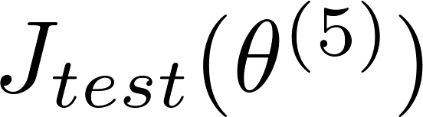

Model selection
1.
2.
3.
10.
Choose
How well does the model generalize? Report test set error .
Problem: is likely to be an optimistic estimate of generalization error. I.e. our extra parameter ( = degree of polynomial) is fit to test set.

Slide 13





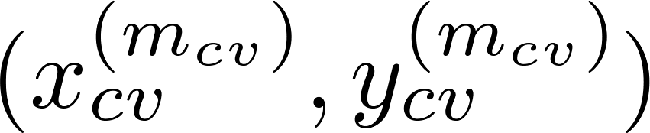
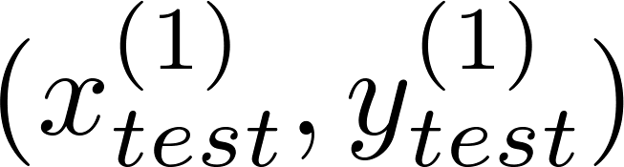
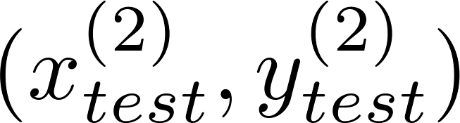
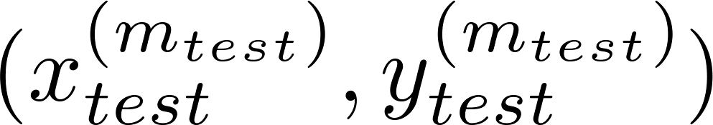
Evaluating your hypothesis
Dataset:
Size | Price
2104 | 400
1600 | 330
2400 | 369
1416 | 232
3000 | 540
1985 | 300
1534 | 315
1427 | 199
1380 | 212
1494 | 243

Slide 14
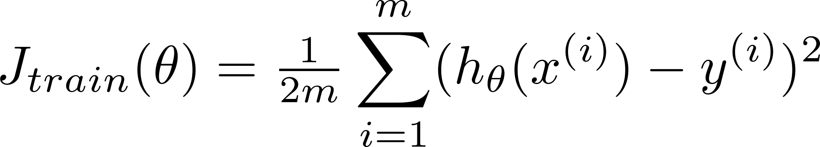
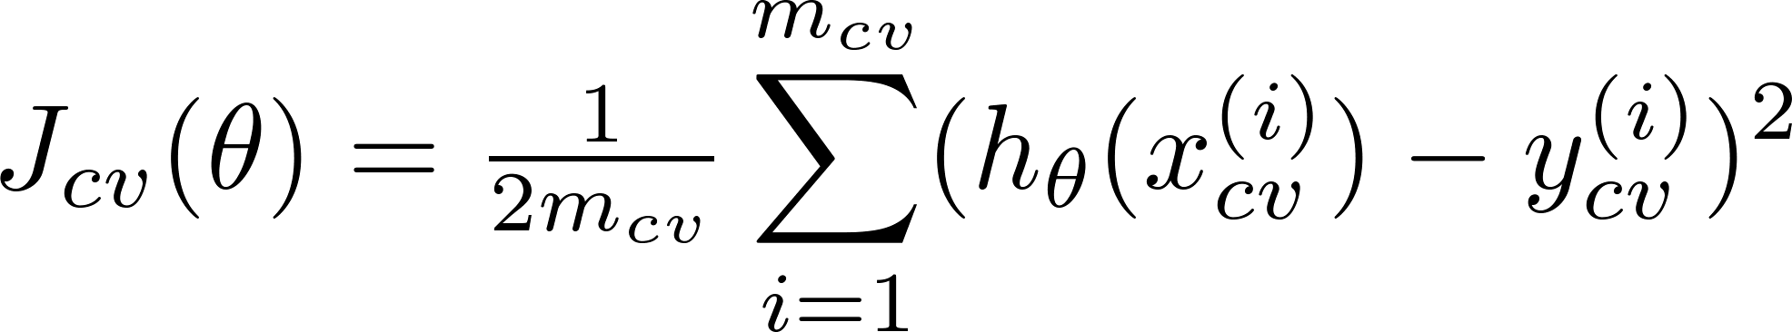
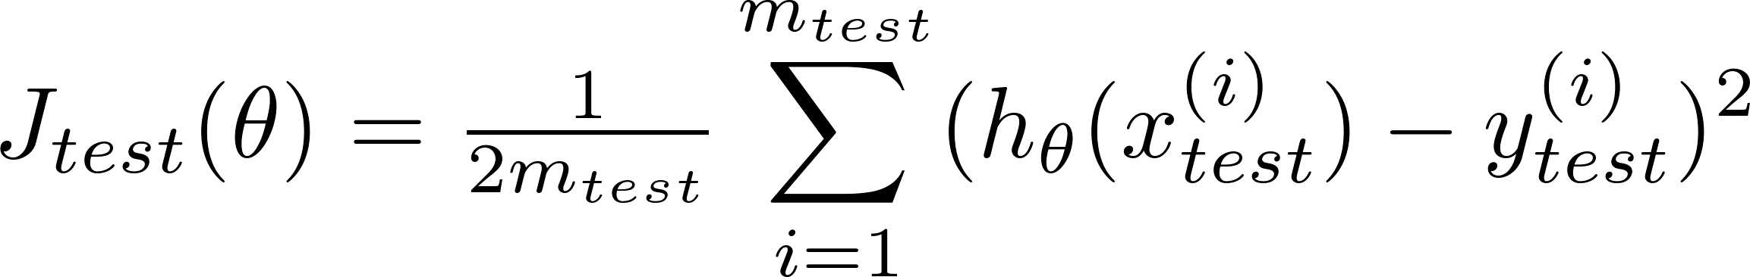
Train/validation/test error
Training error:
Cross Validation error:
Test error:

Slide 15
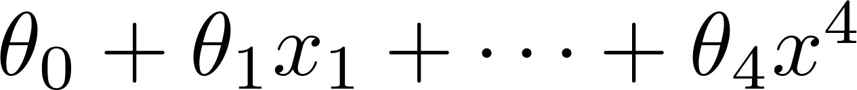
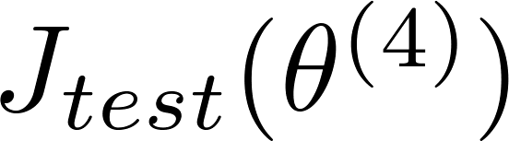
Model selection
1.
2.
3.
10.
Pick
Estimate generalization error for test set

Slide 16
Diagnosing bias vs. variance
Advice for applying machine learning
Machine Learning

Slide 17
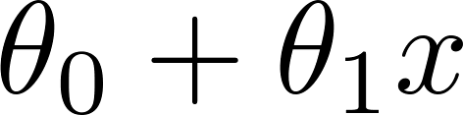
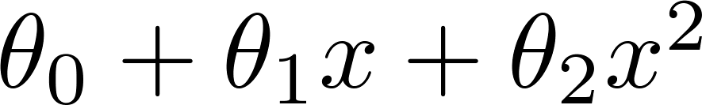
Bias/variance
Price
Price
Price
Size
Size
Size
High bias
(underfit)
“Just right”
High variance
(overfit)

Slide 18
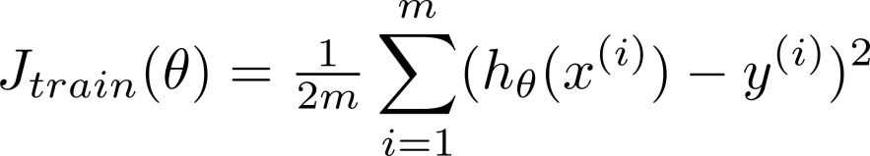
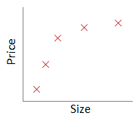
Bias/variance
Training error:
Cross validation error:
price
error
size
degree of polynomial d

Slide 19
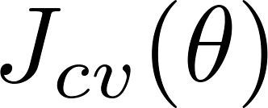
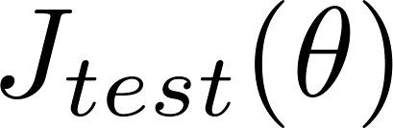


Diagnosing bias vs. variance
Suppose your learning algorithm is performing less well than you were hoping. ( or is high.) Is it a bias problem or a variance problem?
Bias (underfit):
(cross validation
error)
error
Variance (overfit):
(training error)
degree of polynomial d

Slide 20
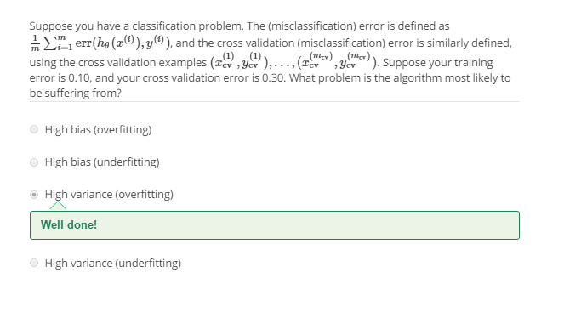

Slide 21
Regularization and bias/variance
Advice for applying machine learning
Machine Learning

Slide 22
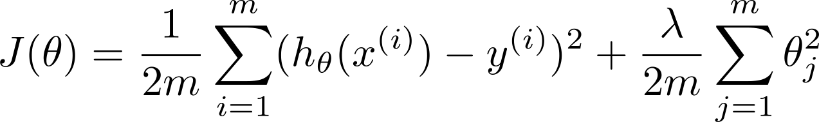


Linear regression with regularization
Model:
Price
Price
Price
Size
Size
Size
Large xx
High bias (underfit)
Intermediate xx
“Just right”
Small xx
High variance (overfit)

Slide 23
Choosing the regularization parameter

Slide 24
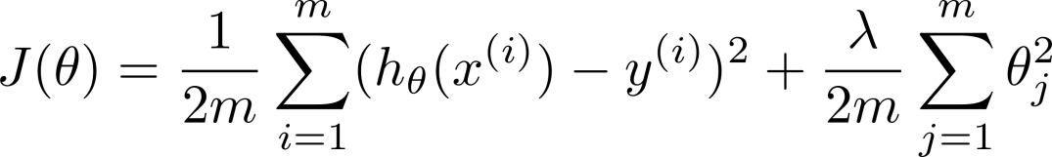







Choosing the regularization parameter
Model:
Try
Try
Try
Try
Try
Try
Pick (say) . Test error:

Slide 25
Bias/variance as a function of the regularization parameter

Slide 26
Learning curves
Advice for applying machine learning
Machine Learning

Slide 27
Learning curves
error
(training set size)

Slide 28

High bias
price
error
size
(training set size)
price
If a learning algorithm is suffering from high bias, getting more training data will not (by itself) help much.
size

Slide 29
High variance
(and small )
error
price
size
(training set size)
price
If a learning algorithm is suffering from high variance, getting more training data is likely to help.
size

Slide 30
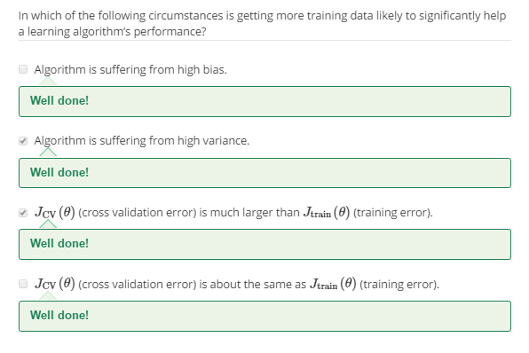

Slide 31
Deciding what to try next (revisited)
Advice for applying machine learning
Machine Learning

Slide 32
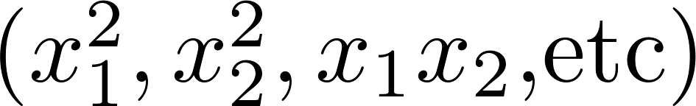
Debugging a learning algorithm:
Suppose you have implemented regularized linear regression to predict housing prices. However, when you test your hypothesis in a new set of houses, you find that it makes unacceptably large errors in its prediction. What should you try next?
Get more training examples
Try smaller sets of features
Try getting additional features
Try adding polynomial features
Try decreasing
Try increasing

Slide 33
Neural networks and overfitting
“Small” neural network
(fewer parameters; more prone to underfitting)
“Large” neural network
(more parameters; more prone to overfitting)
Computationally cheaper
Computationally more expensive.
Use regularization ( ) to address overfitting.

Slide 34
